Slide 1
Discrete Mathematics
Relations

Slide 2
Cartesian Product or Product Set
If A and B are two nonempty sets, we define the product set or Cartesian product A × B as the set of all ordered pairs (a, b) with a ∈ A and b ∈ B. Thus A × B = {(a, b) | a ∈ A and b ∈ B}

Slide 3
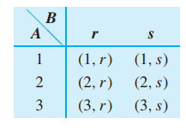
Cartesian Product Example
1) If A = {1, 2, 3} and B = {a, b, c}, find A × B
A × B = {(1,a), (1,b), (1,c), (2,a), (2,b), (2,c), (3,a), (3,b), (3,c)}
2) A = {1, 2, 3} and B = {r,s}; then A × B = {(1,r), (1,s), (2,r), (2,s), (3,r),(3,s)}. Observe that the elements of A × B can be arranged in a convenient tabular array
If A and B are as in Example 2, then B × A = {(r, 1), (s, 1), (r, 2), (s, 2), (r, 3), (s, 3)}.

Slide 4
Using Matrices to Denote Cartesian Product
For Cartesian Product of two sets, you can use a matrix to find the sets.
Example: Assume A = {1, 2, 3} and B = {a, b, c}. The table below represents A × B.
 | a | b | c
1 | (1, a) | (1, b) | (1, c)
2 | (2, a) | (2, b) | (2, c)
3 | (3, a) | (3, b) | (3, c)

Slide 5
Theorem : Cardinality of Cartesian Product
If A1, A2, …, Am are nonempty sets, then the Cartesian Product of them or Product Sets is the set of all ordered m-tuples (a1, a2, …, am), where ai ∈ Ai,
i = 1, 2m … m. Denoted A1 × A2 ×···× Am = {(a1, a2,..., am) | ai ∈ Ai, i = 1, 2,..., m}
The cardinality of the Cartesian Product equals the product of the cardinality of all of the sets:
| A₁ × A₂ × … × A_{m} | = | A₁ | ⋅ | A₂ | ⋅ … ⋅ | A_{m} |

Slide 6
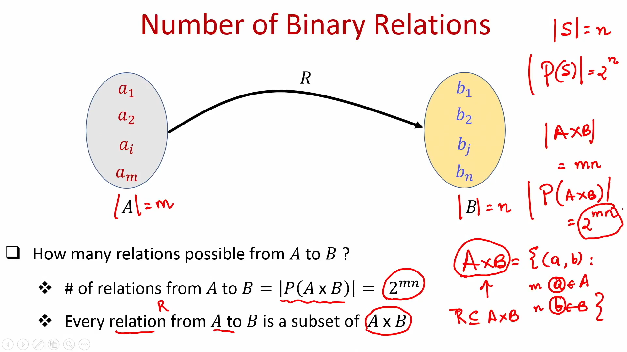

Slide 7
Subsets of the Cartesian Product
Many of the results of operations on sets produce subsets of the Cartesian Product set
Relational database
Each column in a database table can be considered a set
Each row is an m-tuple of the elements from each column or set
No two rows should be alike

Slide 8
Relations
A relation, R, is a subset of a Cartesian Product that uses a definition to state whether an m-tuple is a member of the subset or not
Terminology: Relation R from A to B
R ⊆ A × B
Denoted “x R y” where x ∈ A and y ∈ B and x has a relation with y
If x does not have a relation with y, denoted
x R y

Slide 9
Relation Example
A is the set of all students and B is the set of all courses
A relation R may be defined as the course is required
NAVUDURI VASISTA R SYBTech_Comp_A
Newton R SYBTech_Comp_A

Slide 10
Relations Across Same Set
Relations may be from one set to the same set, i.e., A = B
Terminology: Relation R on A R ⊆ A × A

Slide 11
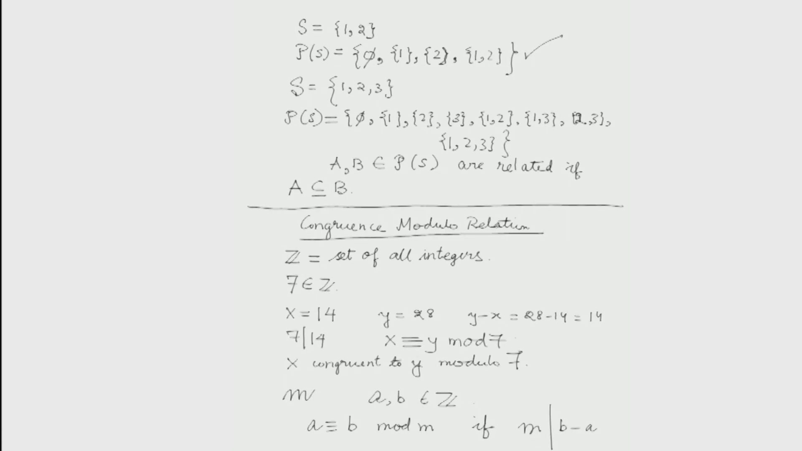

Slide 12
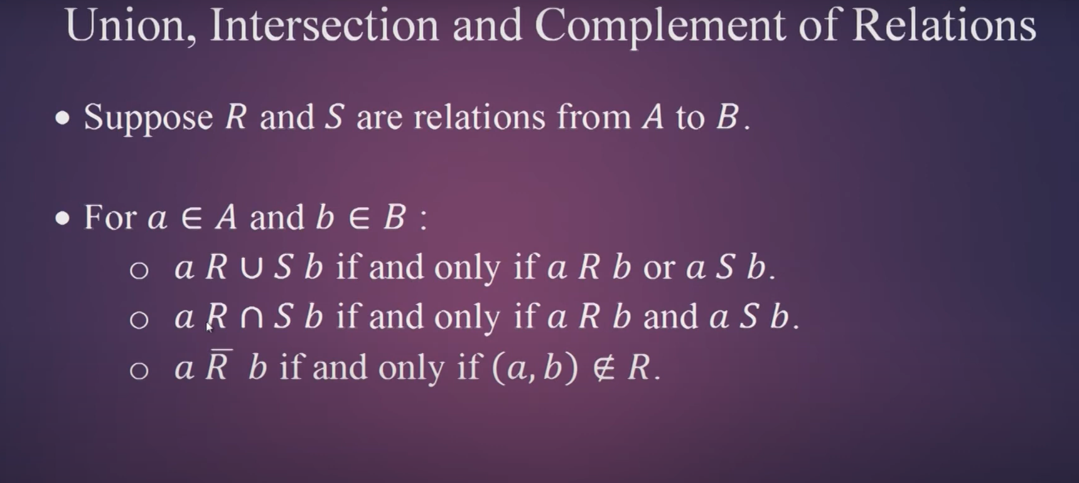

Slide 13
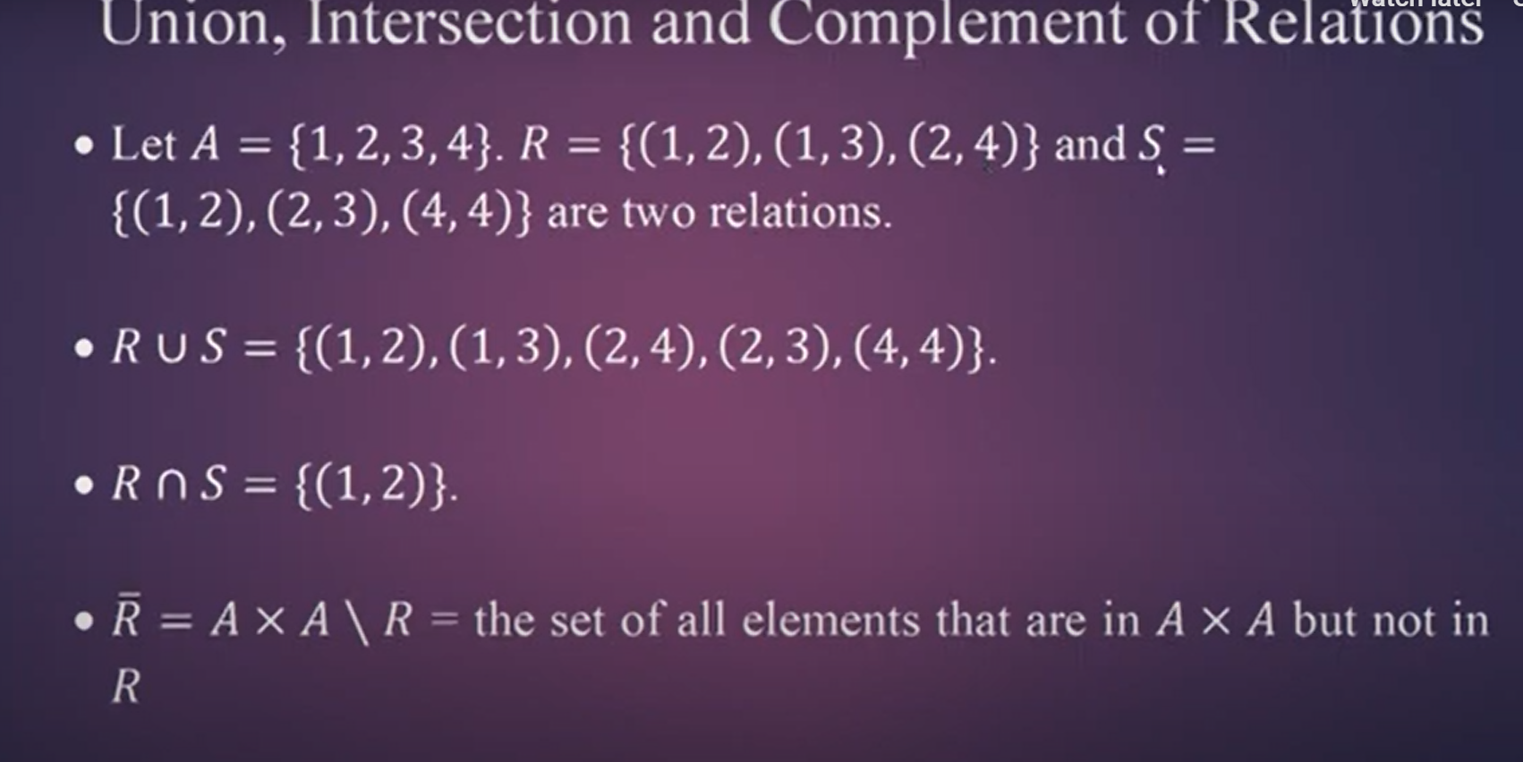

Slide 14
The domain of R:
denoted by Dom(R)
is the set of elements in A that are related to some element in B
Also called a subset of A, is the set of all first elements in the pairs that make up R
The range of R:
denoted by Ran(R)
to be the set of elements in B that are second elements of pairs in R
all elements in B that are paired with some element in A.
Example:
Let A = {1, 2, 3, 4, 5}. Define the following relation R (less than) on A:
aRb if and only if a < b.
Then
R = {(1, 2), (1, 3), (1, 4), (1, 5), (2, 3), (2, 4), (2, 5), (3, 4), (3, 5), (4, 5)}.
Dom(R) = A and Ran(R) = B

Slide 15
A={1,2,3,4,5} R = A xA ={ (1,2),(1,3),(1,4).(1,5), Relation on a Single Set Example skip
A is the set of all courses
A relation R may be defined as the course is a prerequisite
CSCI 2150 R CSCI 3400
R = {(CSCI 2150, CSCI 3400), (CSCI 1710, CSCI 2910), (CSCI 2800, CSCI 2910), …}

Slide 16
Example: Features of Digital Cameras skip
Megapixels = {<2, 3 to 4, >5}
battery life = {<200 shots, 200 to 400 shots, >400 shots}
optical zoom = {none, 2X to 3X, 4X or better}
storage capacity = {<32 MB, 32MB to 128MB, >128MB}
price = Z+

Slide 17
Digital Camera Example (continued)
Possible relations might be:
Priced below $X
above a certain megapixels
a combination of price below $X and optical zoom of 4X or better

Slide 18
Theorems of Relations
Let R be a relation from A to B, and let A₁ and A₂ be subsets of A
If A₁ ⊆ A₂, then R(A₁) ⊆ R(A₂)
R(A₁ ∪ A₂) = R(A₁) ∪ R(A₂)
R(A₁ ∩ A₂) ⊆ R(A₁) ∩ R(A₂)
Let R and S be relations from A to B. If R(a) = S(a) for all a in A, then R = S.

Slide 19
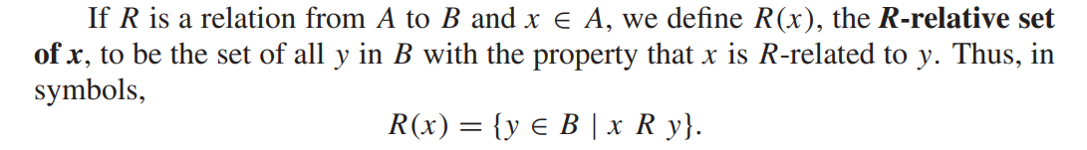
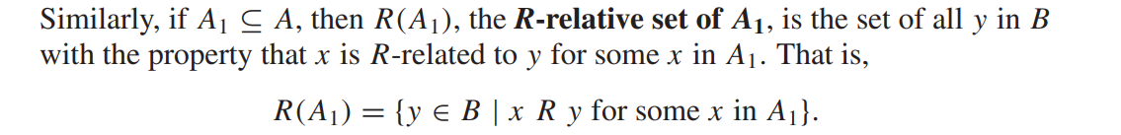
R- relative set of x
Example:

Slide 20
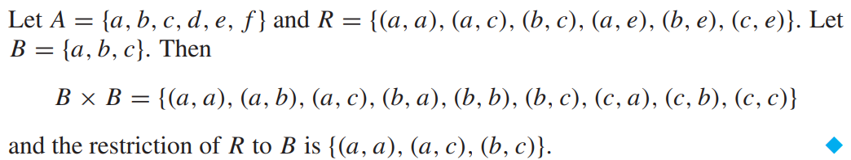
Restriction of R to B
If R is a relation on a set A, and B is a subset of A, the restriction of R to B is R ∩ (B × B).
Example:

Slide 21
Exercise:
A) Find the domain, range, matrix, and, when A = B, the digraph of the relation R.
A = {1, 2, 3, 4, 8} = B; aRb if and only if a = b.
A = {1, 2, 3, 4, 6} = B; aRb if and only if a is a multiple of b.
A = {1, 2, 3, 4, 8} = B; aRb if and only if a + b ≤ 9.
B) Let A = R. Consider the following relation R on A: aRb if and only if 2a + 3b = 6. Find Dom(R) and Ran(R).

Slide 22
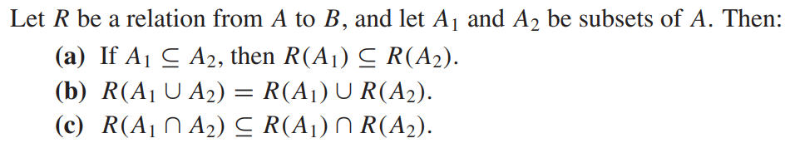
Theorem:

Slide 23
Matrix of a Relation
We can represent a relation between two finite sets with a matrix
M_{R} = [m_{ij}], where
1 if (a_{i}, b_{j}) ∈ R 0 if (a_{i}, b_{j}) ∉ R
_{Mij} =

Slide 24
Example of Using a Matrix to Denote a Relation
Using the previous example where A = {1, 2, 3} and B = {a, b, c}. The matrix below represents the relation R = {(1, a), (1, c), (2, c), (3, a), (3, b)}.
 | a | b | c
1 | 1 | 0 | 1
2 | 0 | 0 | 1
3 | 1 | 1 | 0

Slide 25
Digraph of a Relation
Let R be a relation on A
We can represent R pictorially as follows
Each element of A is a circle called a vertex
If a_{i} is related to a_{j}, then draw an arrow from the vertex a_{i} to the vertex a_{j}
In degree = number of arrows coming into a vertex
Out degree = number of arrows coming out of a vertex

Slide 26
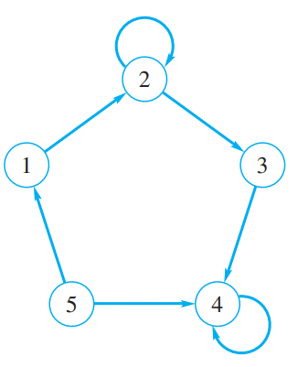
Representing a Relation
The following three representations depict the same relation on A = {1, 2, 3}.
2
1
R = {(1, 1), (1, 3), (2, 3), (3, 2), (3, 3)}
3
1 | 0 | 1
0 | 0 | 1
0 | 1 | 1
Exercise:
1. Find the relation determined by the digraph and give its matrix

Slide 27
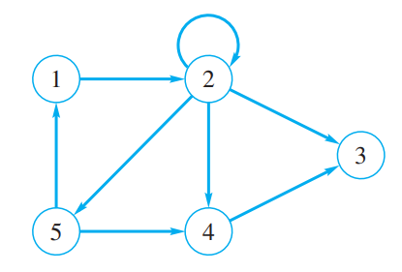
Path in a relation and Diagraph
R is a relation on a set A. A path of length n in R from a to b is a finite sequence
π : a, x1, x2,..., xn−1, b, beginning with a and ending with b,
such that a R x1, x1 R x2, ..., xn−1 R b.
Note that a path of length n involves n + 1 elements of A, although they are not necessarily distinct.
Paths for diagraph :
π1 : 1, 2, 5, 4, 3 is a path of length 4 from vertex 1 to vertex 3,
π2 : 1, 2, 5, 1 is a path of length 3 from vertex 1 to itself, And
π3 : 2, 2 is a path of length 1 from vertex 2 to itself. A path that begins and ends at the same vertex is called a cycle.

Slide 28
Paths in a relation R can be used ---→ to define new relations
If n is a fixed positive integer, we define a relation R^{n} on A as follows:
x R^{n} y means a path of length n from x to y in R.
We may also define a relation R∞ on A, by letting x R∞ y mean that there is some path in R from x to y.
The relation R∞ is sometimes called the connectivity relation for R.

Slide 29
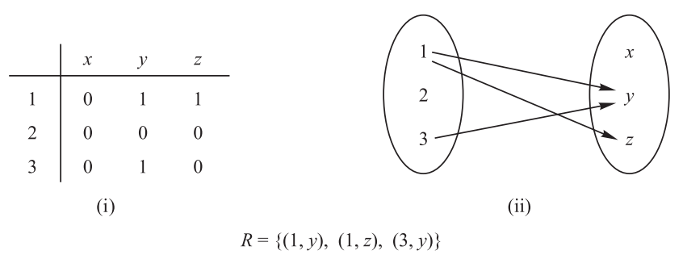
The relation R by the above two ways :

Slide 30
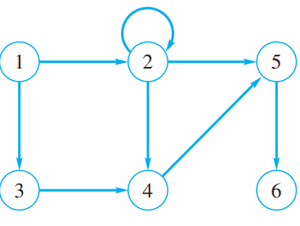
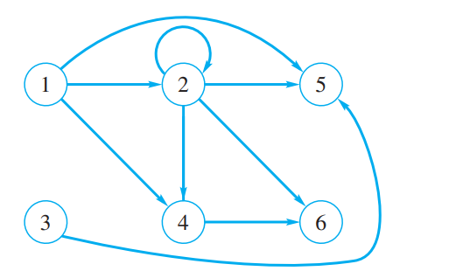
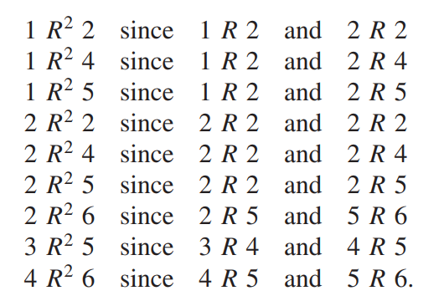
Let A = {1, 2, 3, 4, 5, 6}. Let R be the relation whose digraph is shown in adjacent Figure.
If and only if they are R² – related ←→
if and only if there is a path of length two connecting those vertices in Figure.
The ordered pairs relation R² on A
we can construct the digraph of R^{n} for any n and try with the matrix of relation for the above problem.

Slide 31
COMPOSITION OF RELATIONS
Let A, B and C be sets, and let R be a relation from A to B and let S be a relation from B to C. That is, R is a subset of A × B and S is a subset of B × C.
Then R and S give rise to a relation from A to C denoted by R◦S
And defined by: a(R◦S)c if for some b ∈ B we have aRb and bSc.
That is ,
R ◦ S = {(a, c)| there exists b ∈ B for which (a, b) ∈ R and (b, c) ∈ S}
The relation R◦S is called the composition of R and S; it is sometimes denoted simply by RS
R◦R, the composition of R with itself, is always defined.
Also, R◦R is sometimes denoted by R² = R◦R.
Similarly, R³ = R² ◦R= R◦R◦R, and so on.
Thus R^{n} is defined for all positive n.

Slide 32
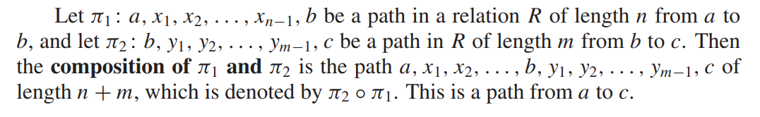
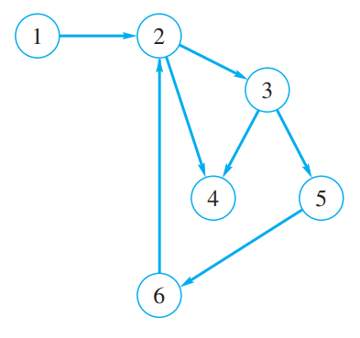
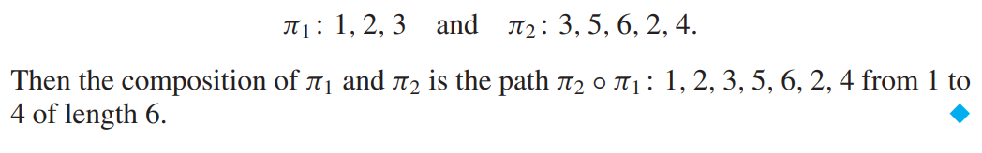

Slide 33
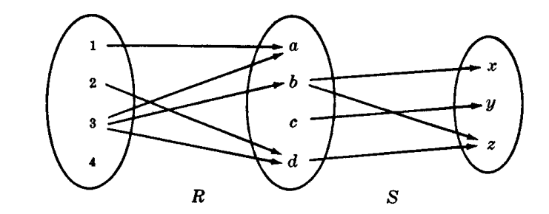
Let A = {1, 2, 3, 4}, B = {a, b, c, d}, C = {x, y,z} and
Let R = {(1, a), (2, d), (3, a), (3, b), (3,d)} and S = {(b, x), (b, z), (c, y), (d, z)}
R ◦ S = {(2, z), (3, x), (3, z)}

Slide 34
Theorem: Let A, B, C and D be sets. Suppose R is a relation from A to B, S is a relation from B to C, and T is a relation from C to D. Then
(R ◦ S) ◦ T = R ◦ (S ◦ T )

Slide 35
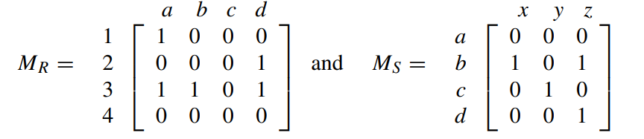
Composition of Relations and Matrices
There is another way of finding R◦S. Let MR and MS denote respectively the matrix representations of the relations R and S. Then
Multiplying M_{R} and M_{S} we obtain the matrix
The nonzero entries in this matrix tell us which elements are related by R◦S. Thus M = M_{R} M_{S} and MR◦S have the same nonzero entries.

Slide 36
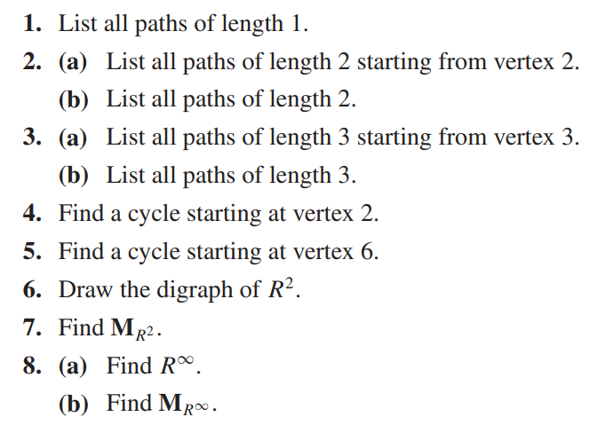
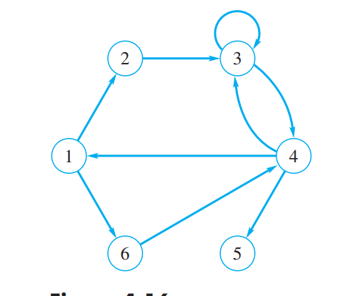
Solve:

Slide 37
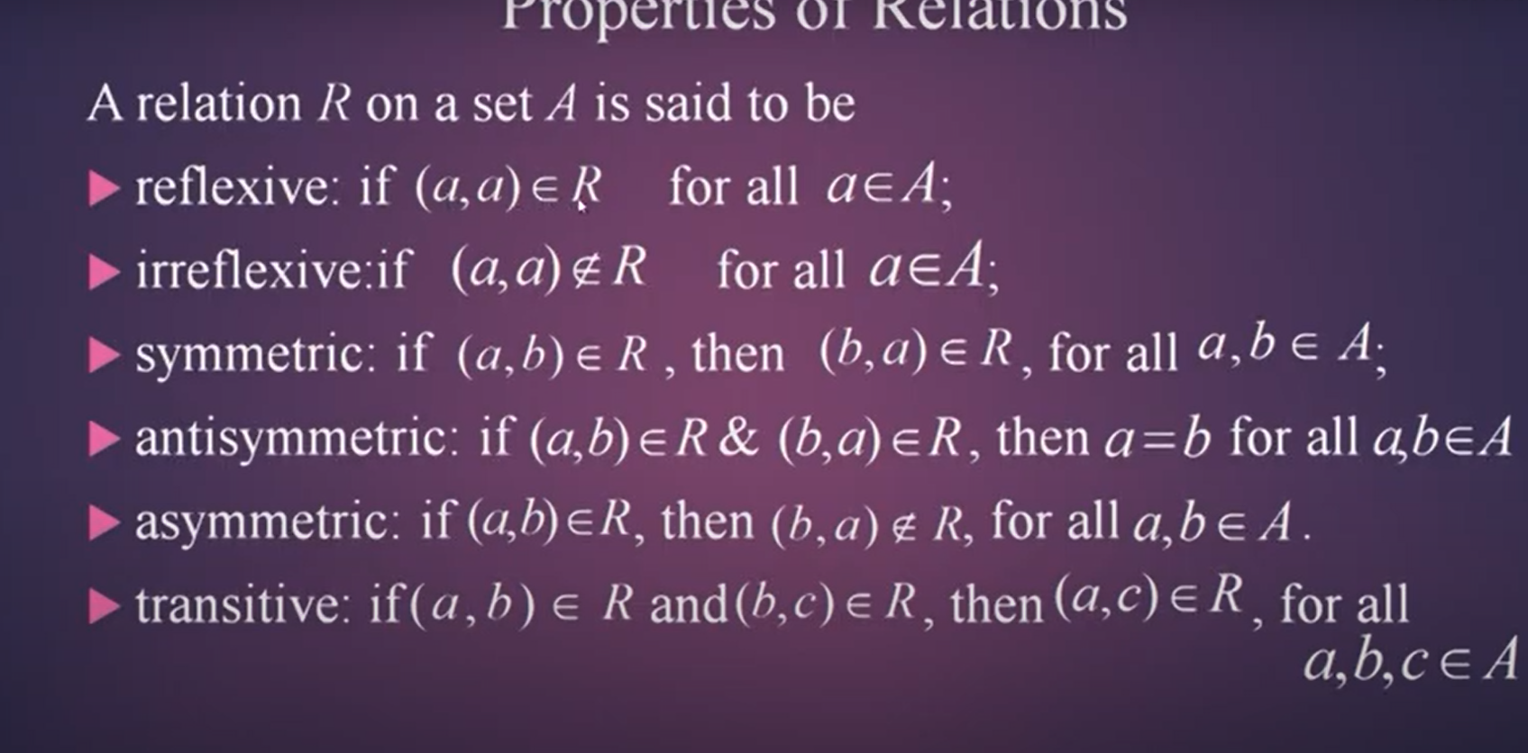

Slide 38
Properties
1. Reflexive Relations
A relation R on a set A is reflexive if aRa for every a ∈ A, that is, if (a, a) ∈ R for every a ∈ A.
Thus R is not reflexive if there exists a ∈ A such that (a, a) ∉ R
Ex1: Consider the following five relations on the set A = {1, 2, 3, 4}:
R1 = {(1, 1), (1, 2), (2, 3), (1, 3), (4, 4)}
R2 = {(1, 1)(1, 2), (2, 1), (2, 2), (3, 3), (4, 4)}
R3 = {(1, 3), (2, 1)}
R4 = ∅, the empty relation
R5 = A × A, the universal relation
Determine which of the relations are reflexive.
Since A contains the four elements 1, 2, 3, and 4, a relation R on A is reflexive if it contains the four pairs (1, 1), (2, 2), (3, 3), and (4, 4).
Thus only R2 and the universal relation R5 = A × A are reflexive.
Note that R1, R3, and R4 are not reflexive since, for example, (2, 2) does not belong to any of them.

Slide 39
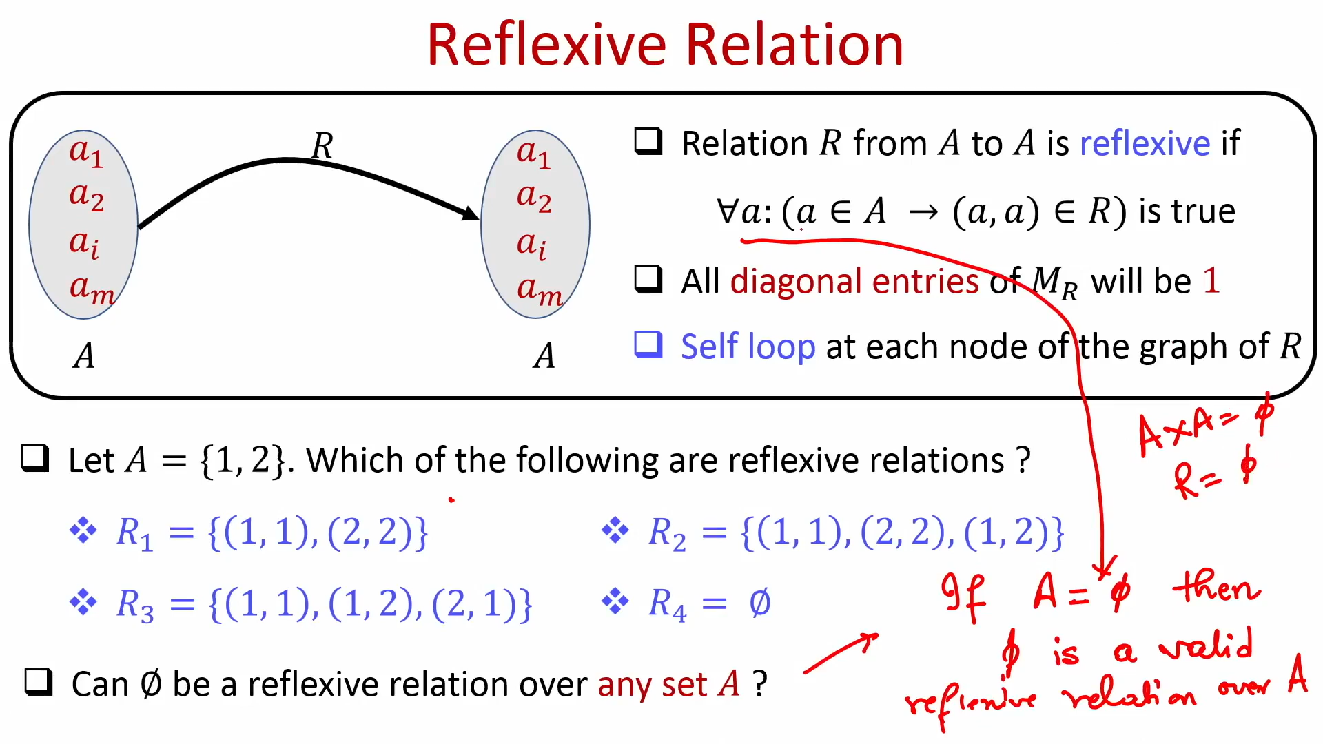

Slide 40
The matrix of a reflexive relation must have all 1’s on its main diagonal, while
the matrix of an irreflexive relation must have all 0’s on its main diagonal.
A reflexive relation has a cycle of length 1 at every vertex, while an irreflexive relation has no cycles of length 1.

Slide 42
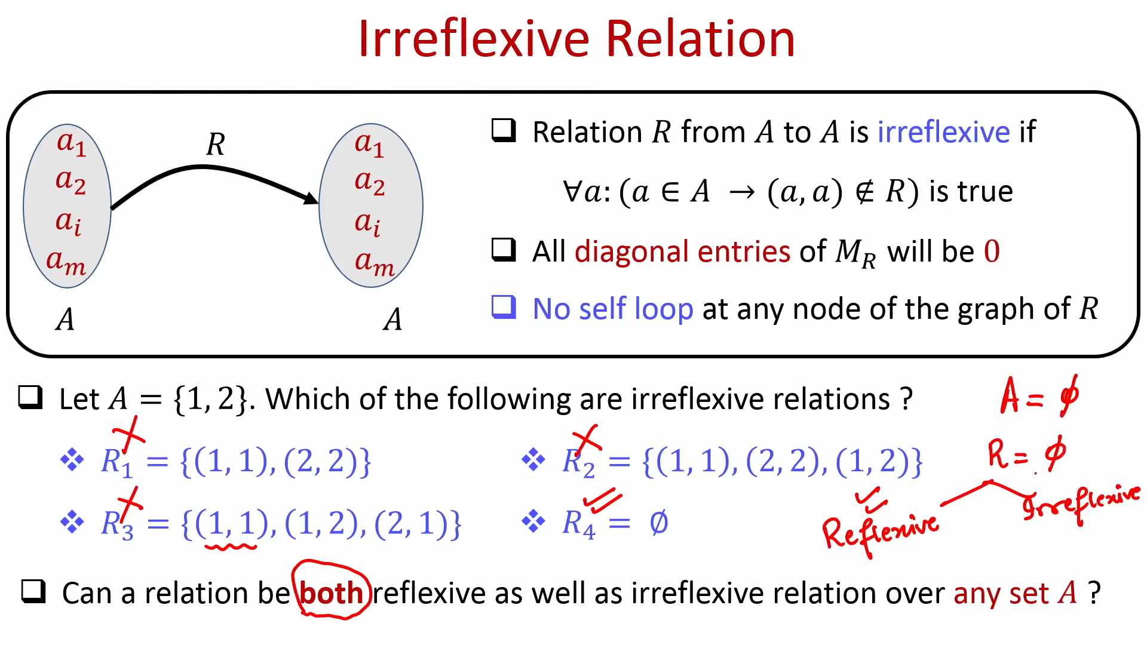

Slide 43
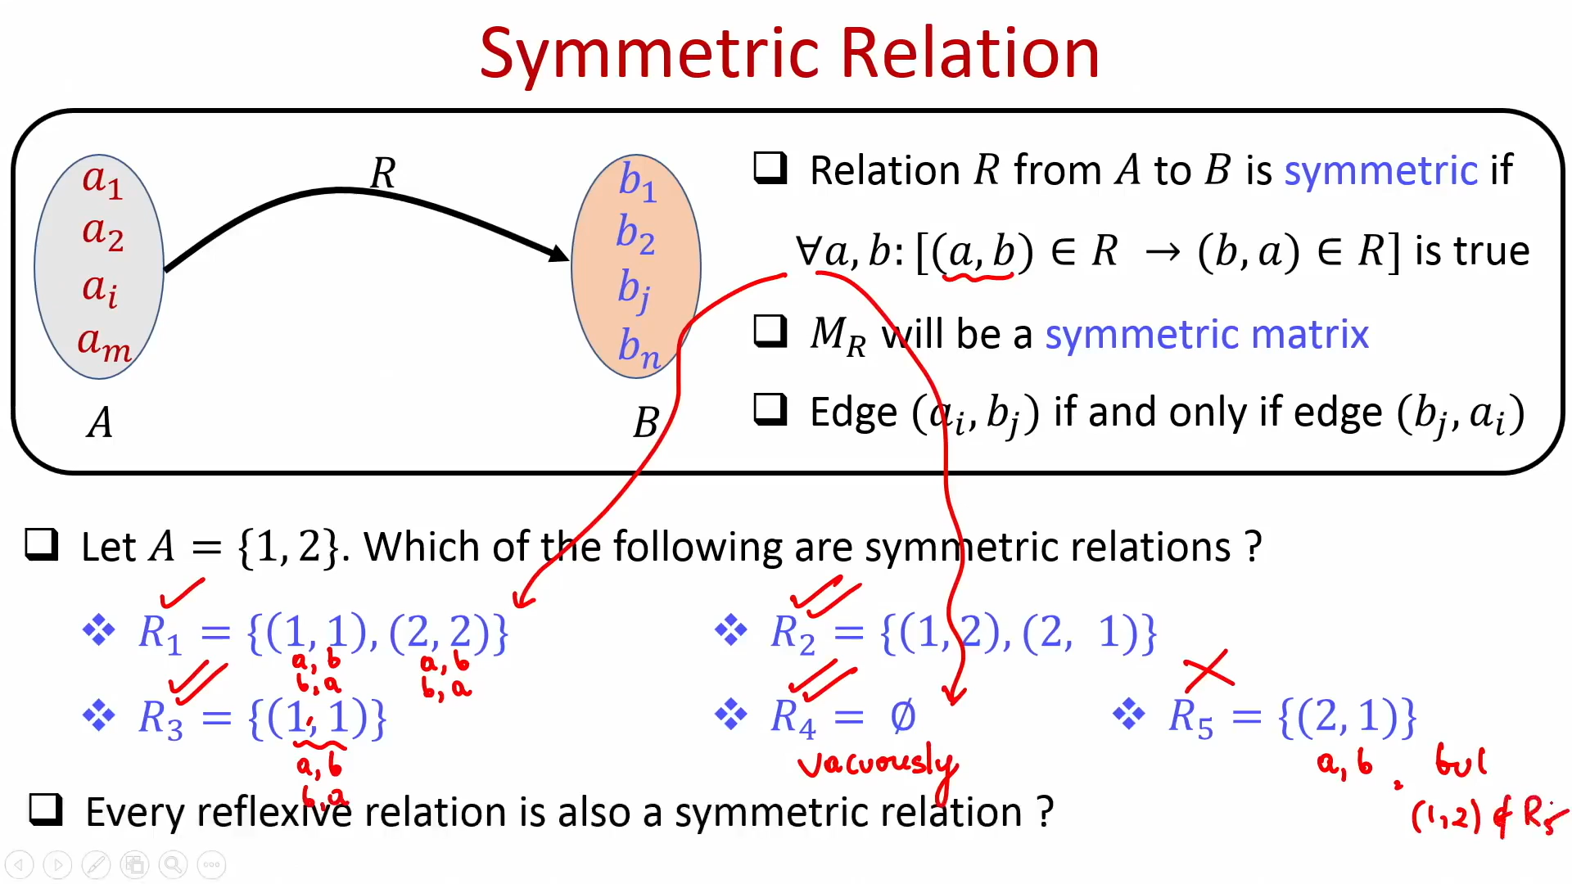

Slide 44
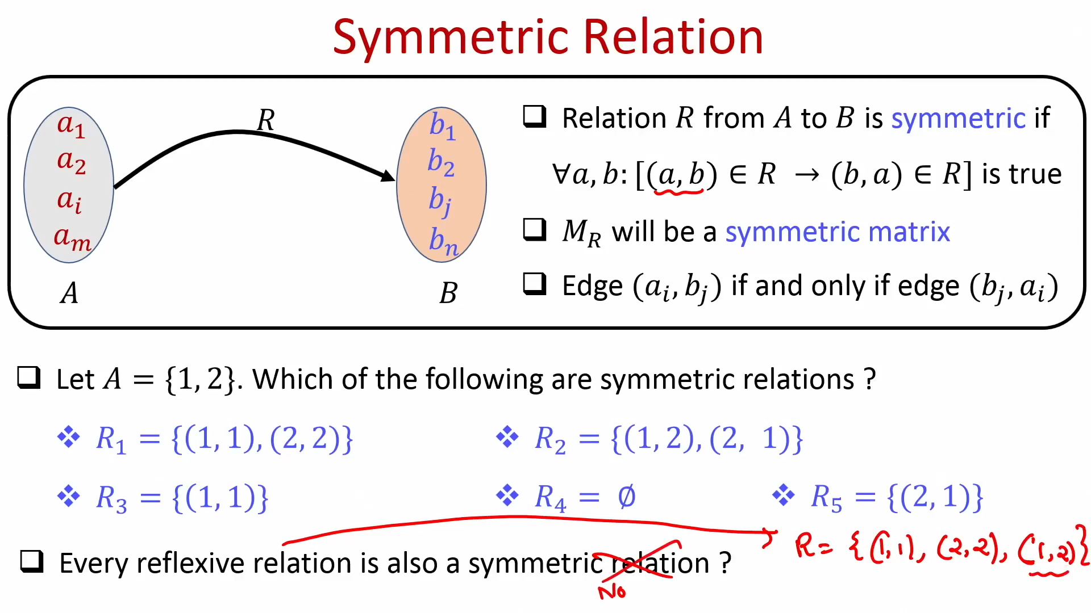

Slide 45
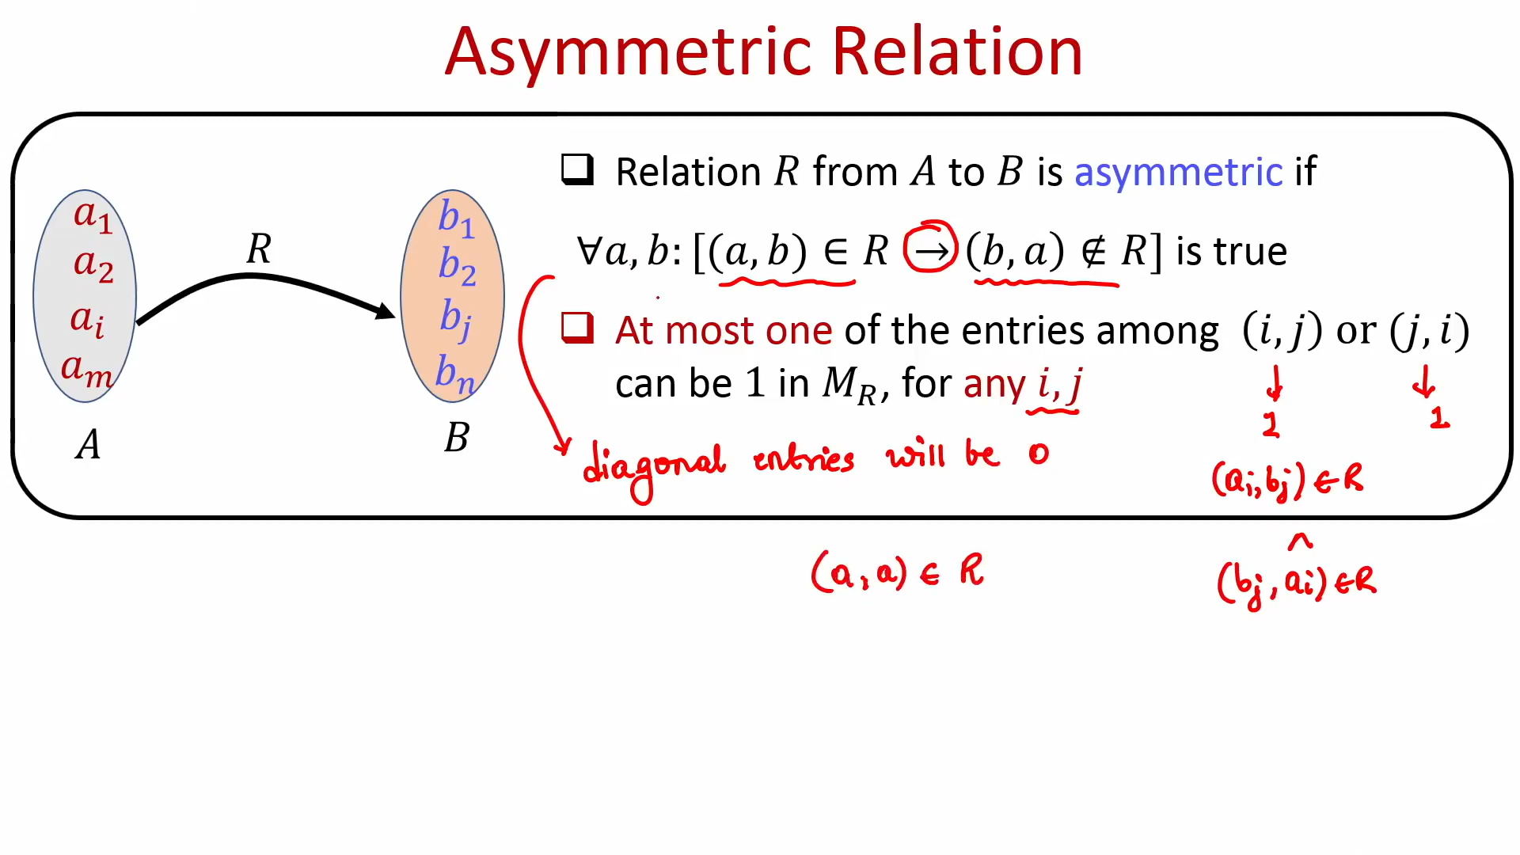

Slide 46
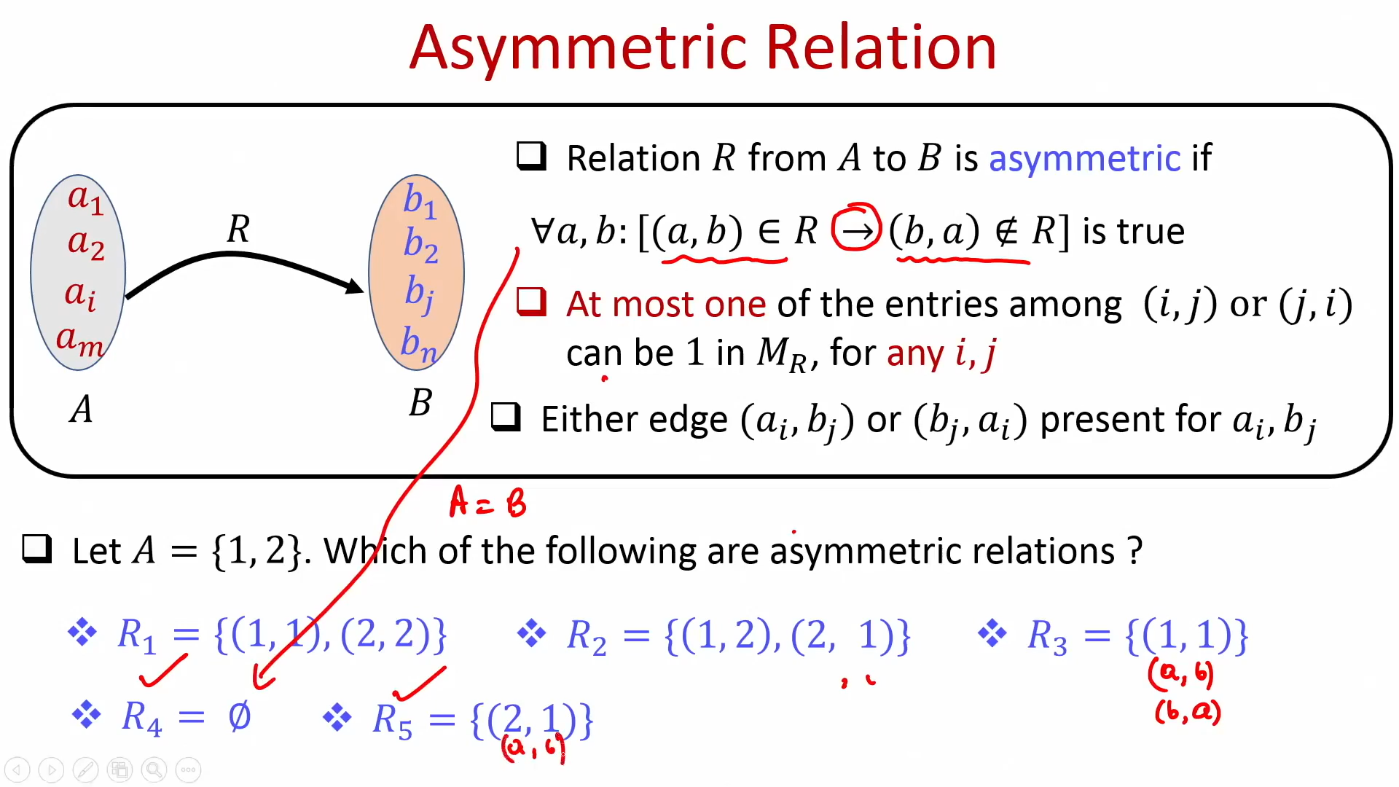

Slide 47
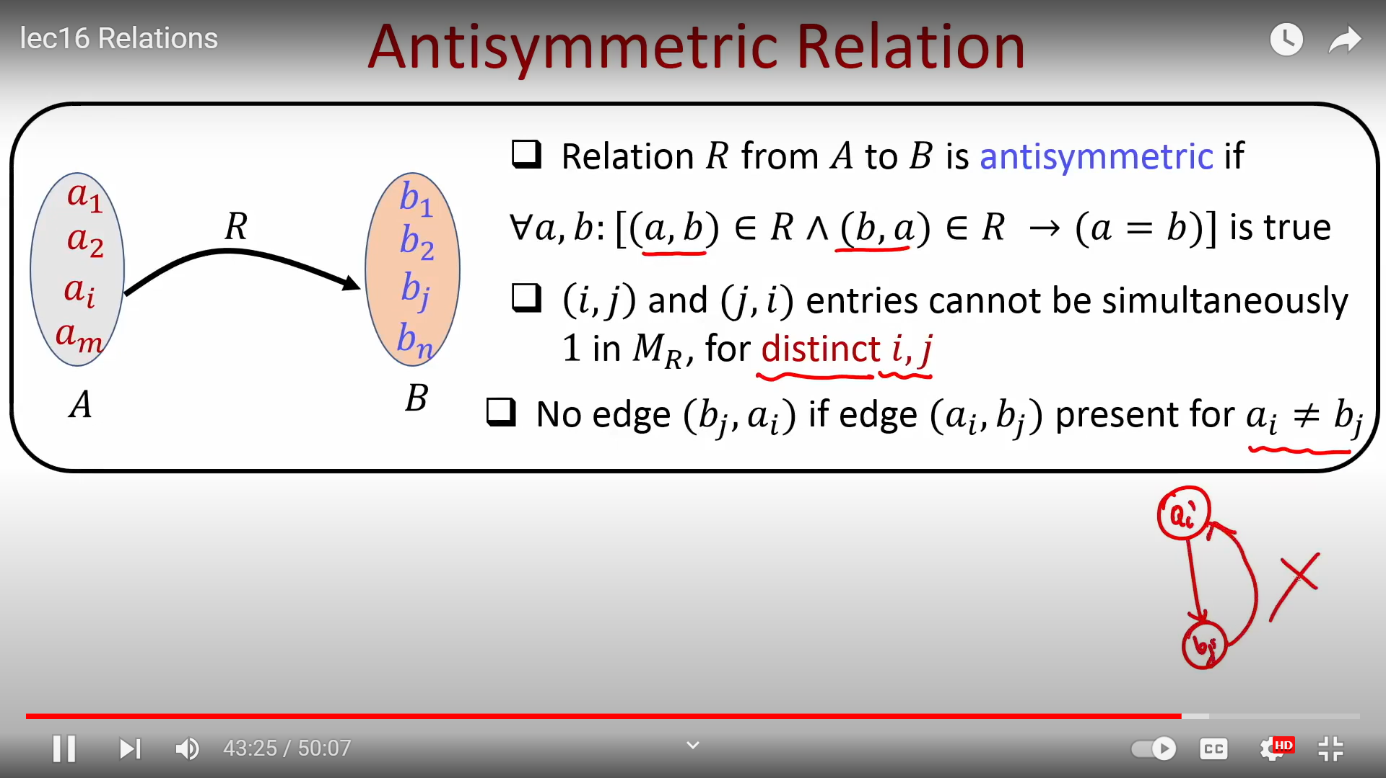

Slide 48
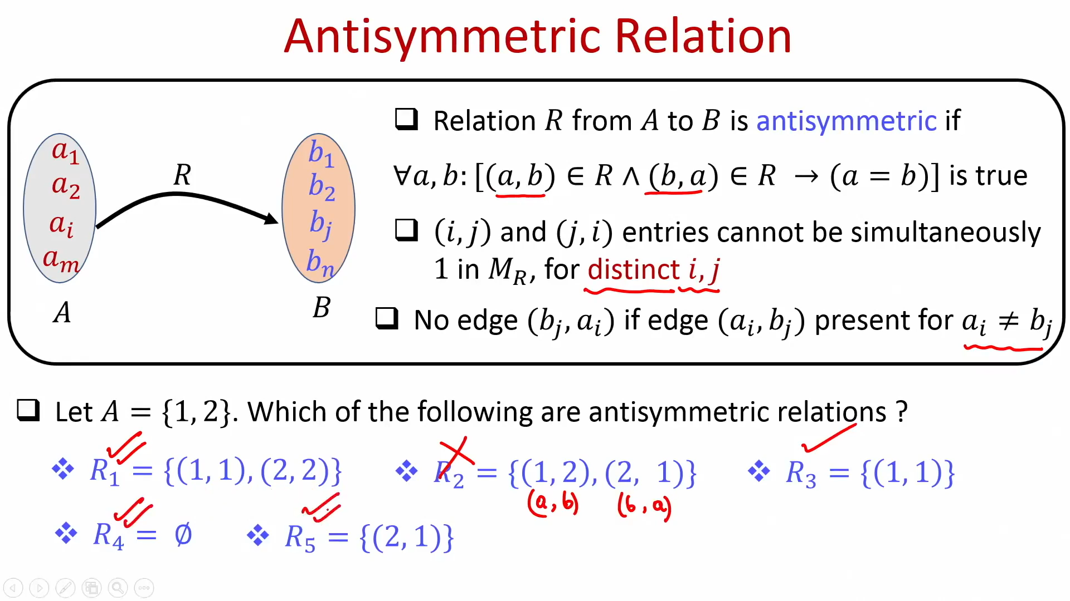

Slide 49
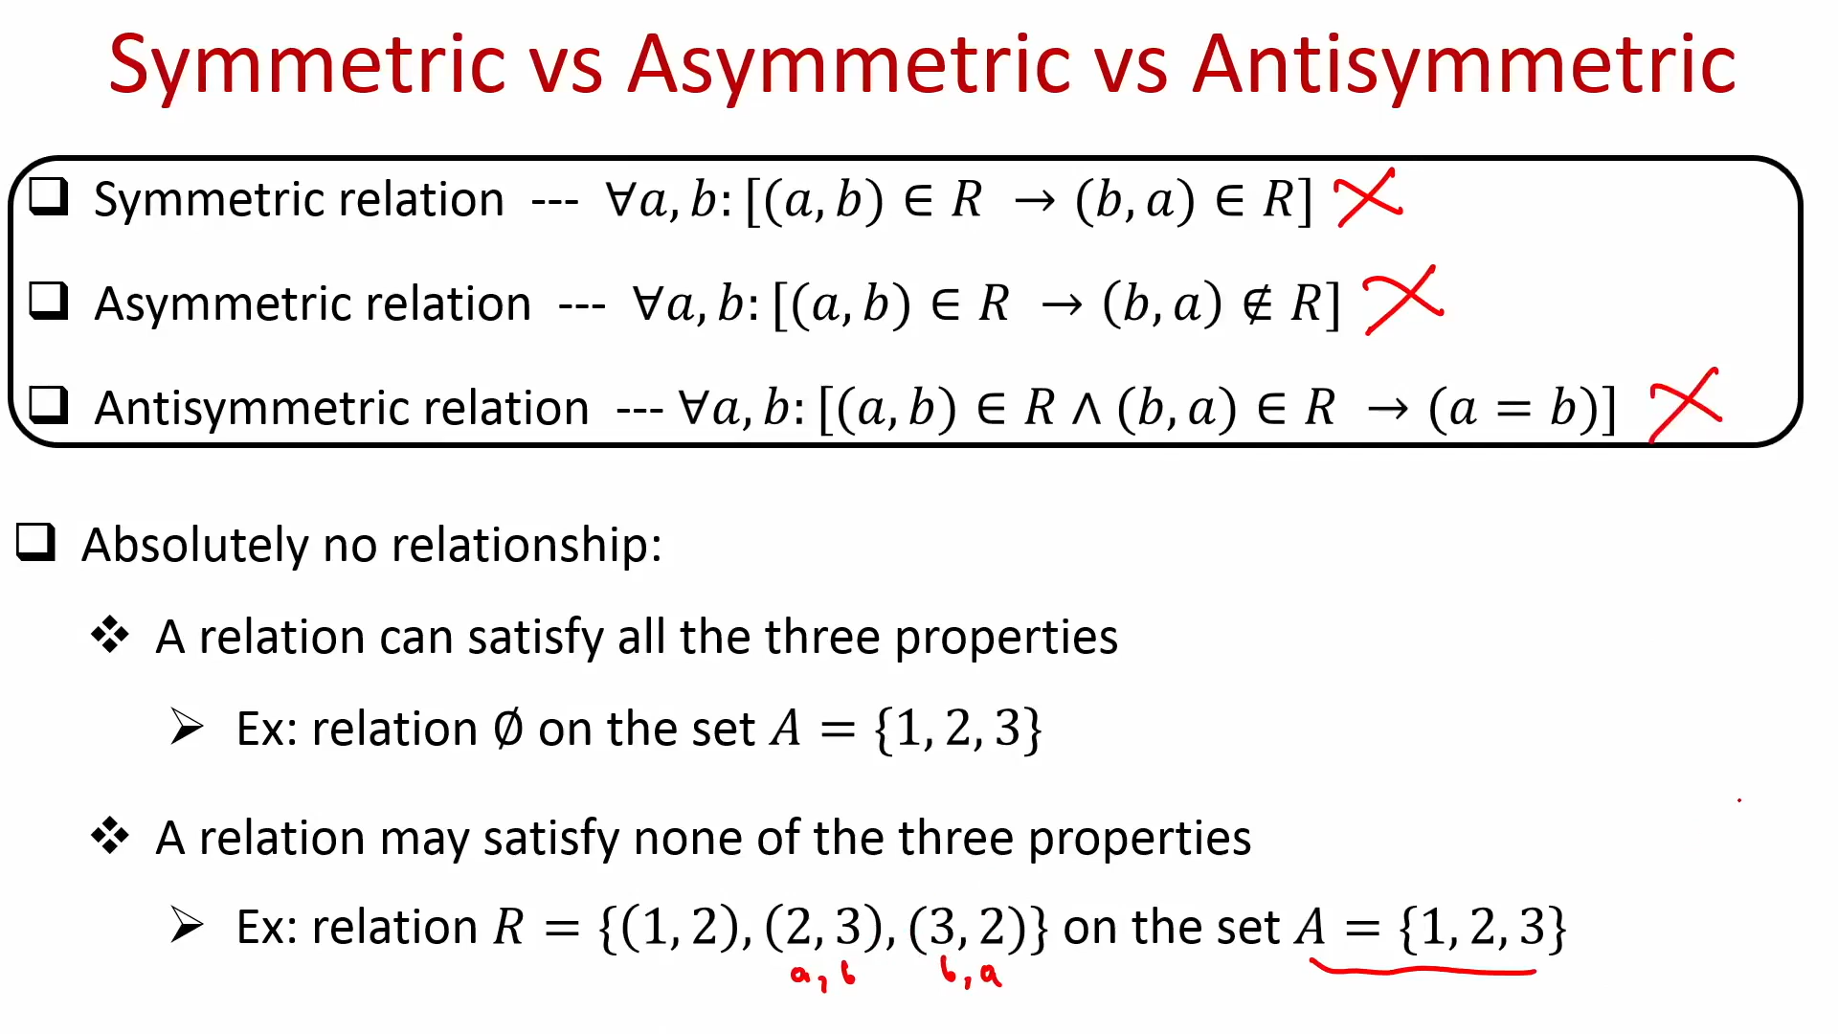

Slide 50
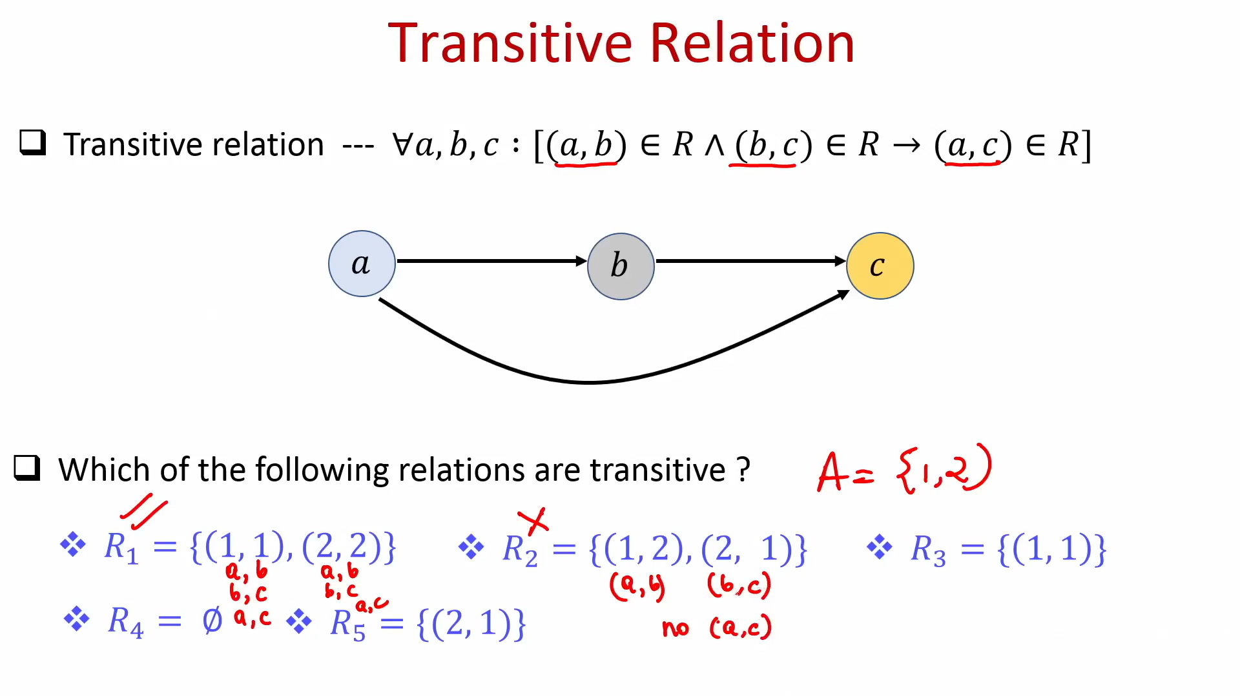

Slide 51
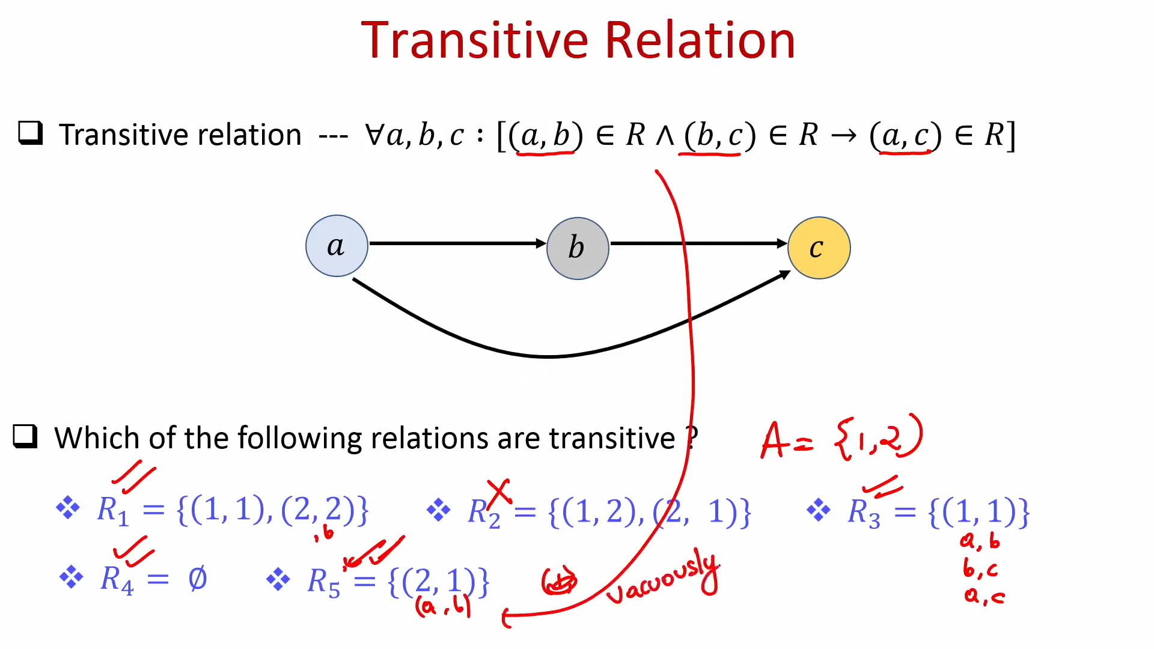

Slide 52
Symmetric and Antisymmetric Relations
2. A relation R on a set A is symmetric
if whenever aRb then bRa, that is,
if whenever(a, b) ∈ R then (b, a) ∈ R.
Thus R is not symmetric or asymmetric if there exists a, b ∈ A such that (a, b) ∈ R but
(b, a) R.
Ex1: Consider the following five relations on the set A = {1, 2, 3, 4}:
R1 = {(1, 1), (1, 2), (2, 3), (1, 3), (4, 4)}
R2 = {(1, 1)(1, 2), (2, 1), (2, 2), (3, 3), (4, 4)}
R3 = {(1, 3), (2, 1)}
R4 = ∅, the empty relation
R5 = A × A, the universal relation

Slide 53
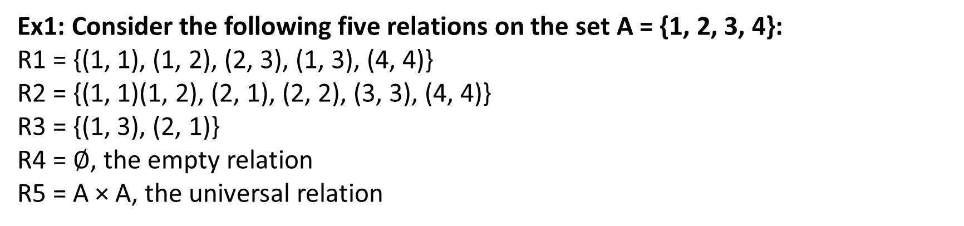
3. A relation R on a set A is antisymmetric
if whenever aRb and bRa then a = b,
that is, if a = b and aRb then bRa.
Thus R is not antisymmetric if there exist distinct elements a and b in A such that aRb and bRa.

Slide 54
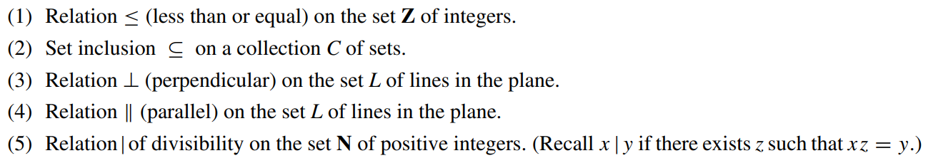
Exercise: Consider the following five relations:
Determine which relations are reflexive, symmetric, and antisymmetric.

Slide 55
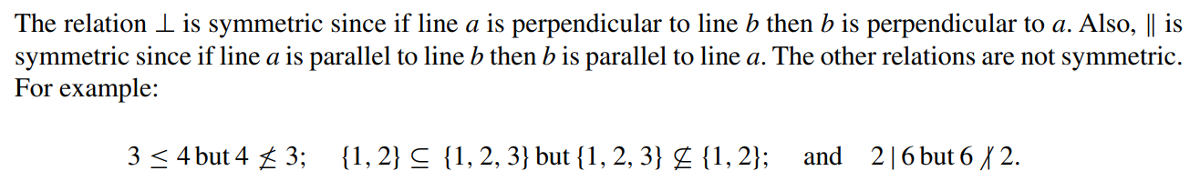
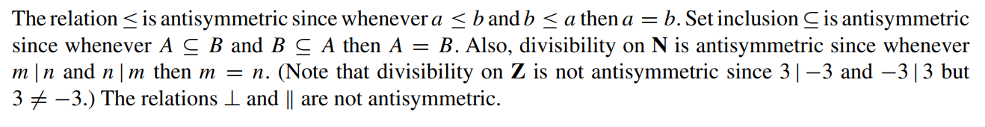

Slide 56
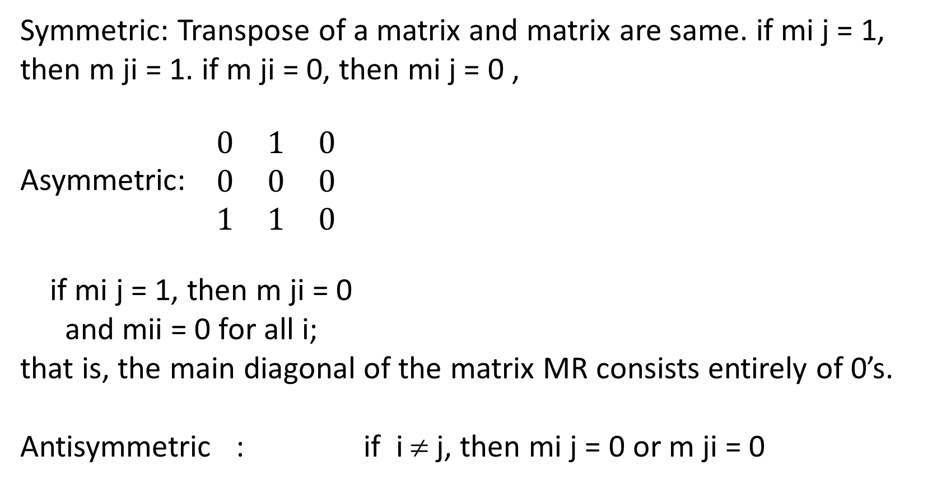
Symmetric: Transpose of a matrix and matrix are same. if mi j = 1, then m ji = 1. if m ji = 0, then mi j = 0 ,
Asymmetric: $\begin{matrix}0 & 1 & 0 \\ 0 & 0 & 0 \\ 1 & 1 & 0\end{matrix}$
if mi j = 1, then m ji = 0
and mii = 0 for all i;
that is, the main diagonal of the matrix MR consists entirely of 0’s.
Antisymmetric : if i ≠ j, then mi j = 0 or m ji = 0

Slide 57
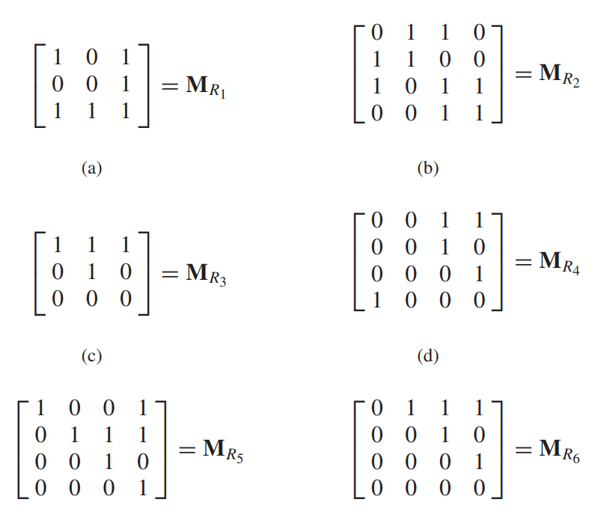
R1, R2…..Symmetric
R3 Antisymmetric, not asymmetric as 1’s in diagonal
R4….Not all 3 symmetric, asymmetric (4,1 1,4) antisymmetric
R5 : antisymmetric, not asymmetric
R6 : asymmetric and antisymmetric

Slide 58
What is an Equivalence Relation?
A relation R on a set A is called an equivalence relation if it is
Reflexive Relation: (a, a) ∈ R ∀ a ∈ A, i.e. aRa for all a ∈ A.
Symmetric Relation: ∀ a, b ∈ A, (a, b) ∈ R ↔ (b, a) ∈ R.
Transitive Relation: ∀ a, b, c ∈ A, if (a, b) ∈ R and (b, c) ∈ R then (a, c) ∈ R.
where R is a subset of (A x A), i.e. the cartesian product of set A with itself.

Slide 59
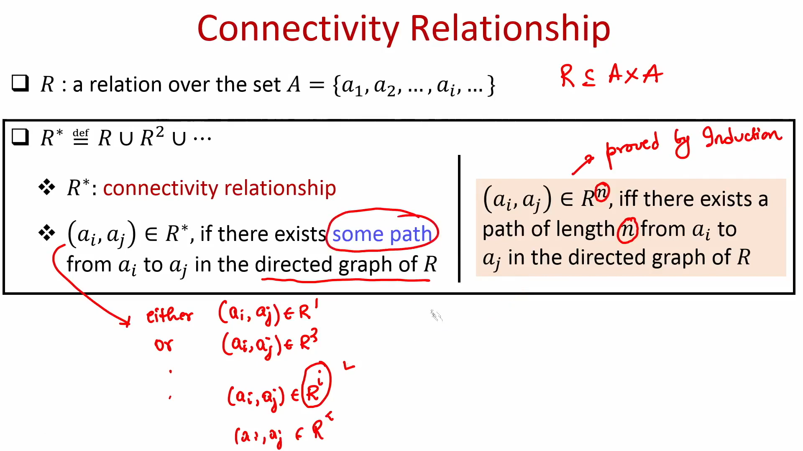

Slide 60
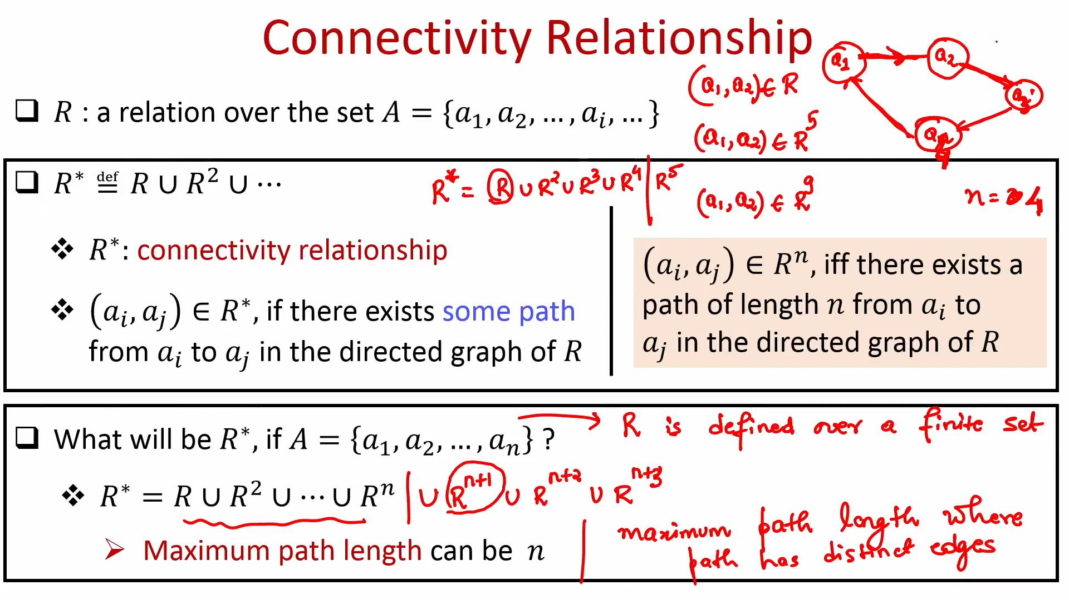

Slide 61
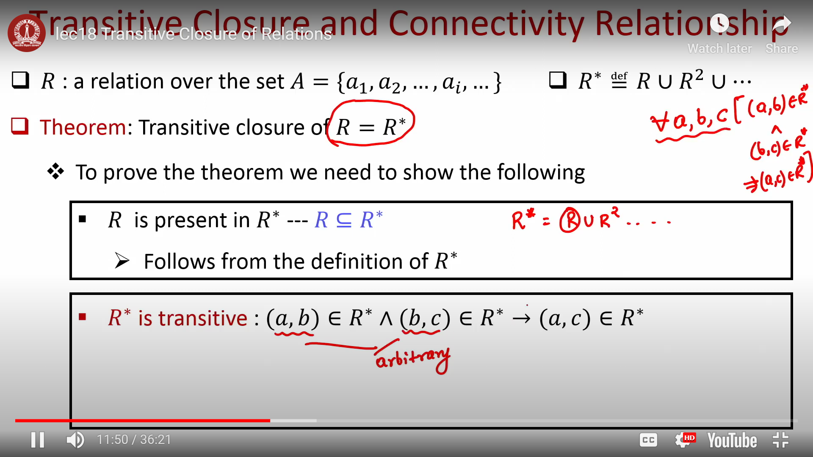

Slide 62
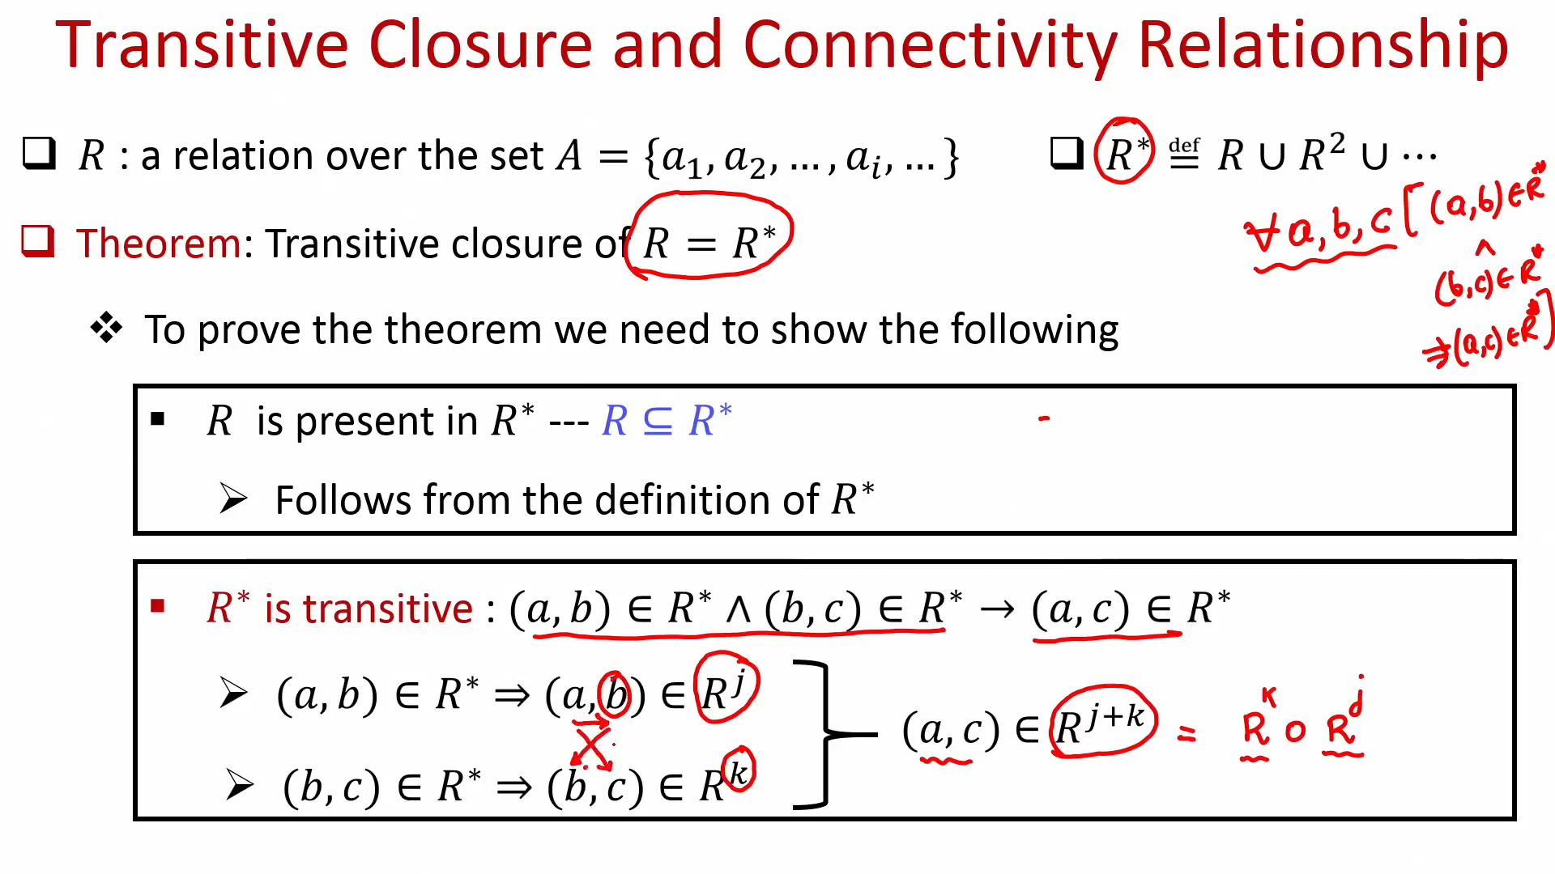

Slide 63
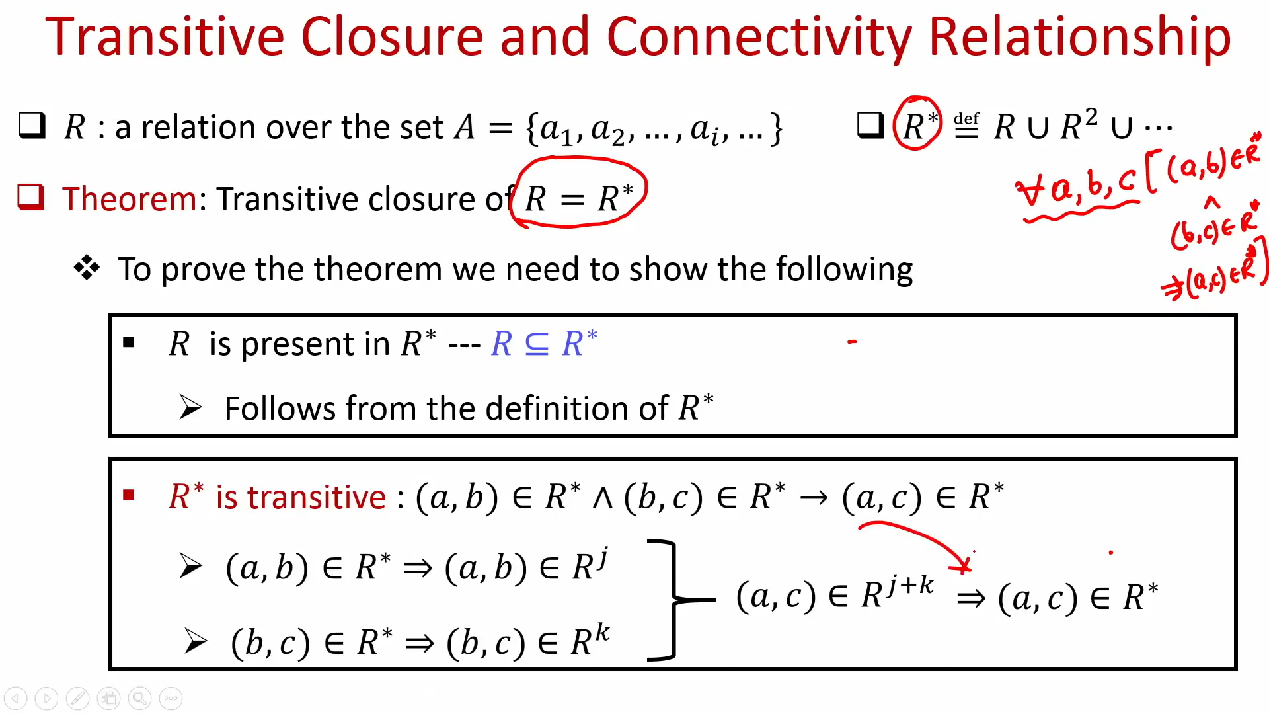

Slide 64
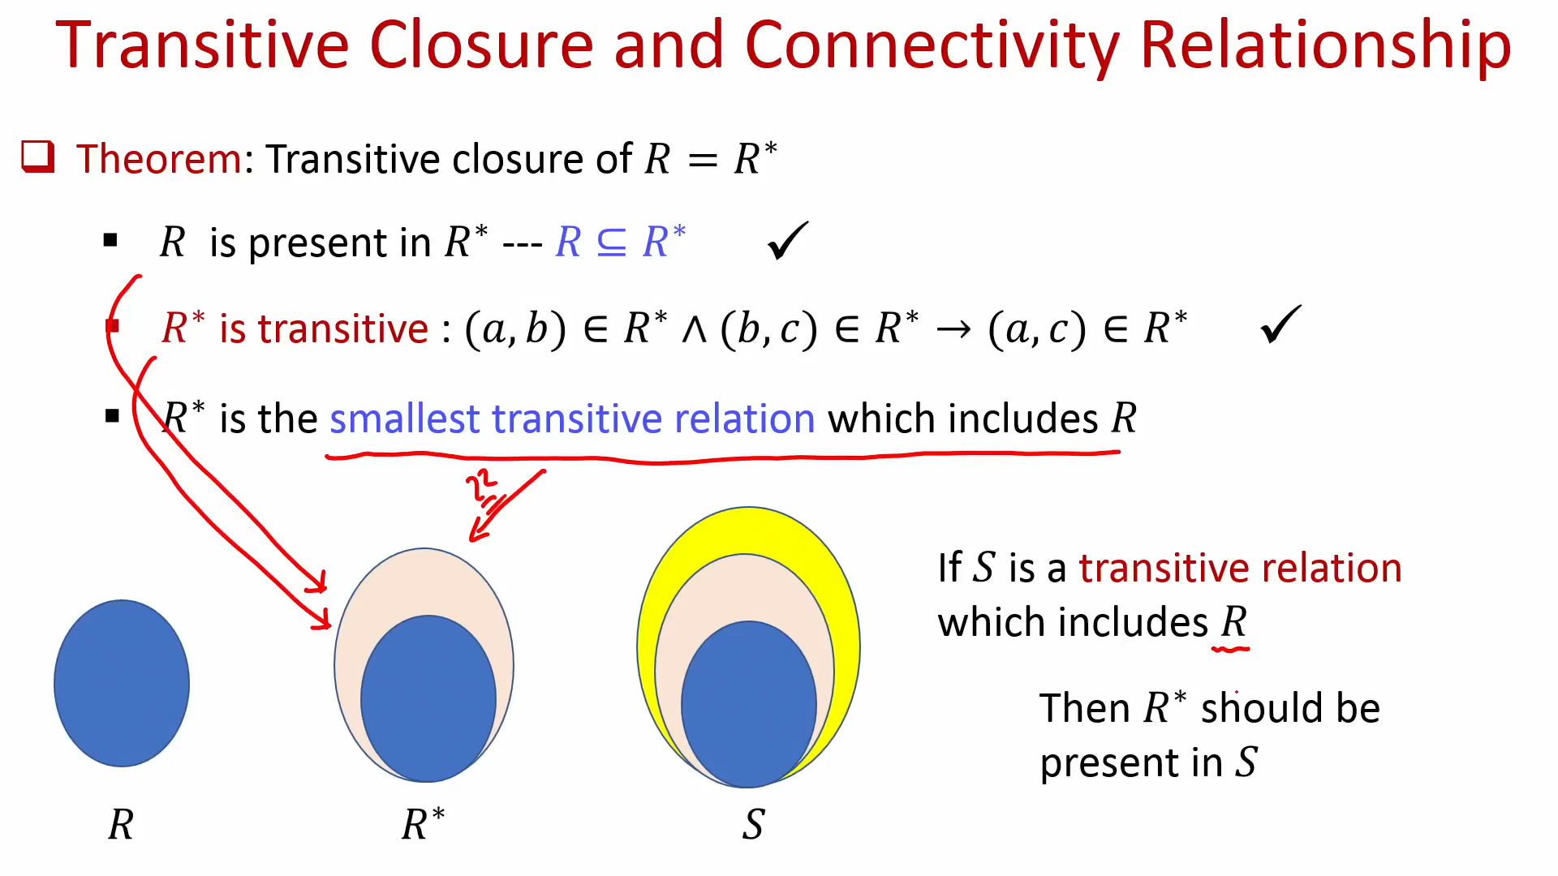

Slide 65
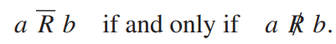
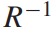
Operations on Relations:
Let R and S be relations from a set A to a set B. Then, if we remember that R and S are simply subsets of A × B, we can use set operations on R and S
1. complementary relation: the complement of R, is referred to as the complementary relation
2. We can also form the intersection R ∩ S and the union R ∪ S of the relations R and S. In relational terms, we see that a R ∩ S b means that aRb and aSb.
3. A different type of operation on a relation R from A to B is the formation of the inverse, usually written . The relation is a relation from B to A (reverse order from R) defined by b a if and only if aRb

Slide 66
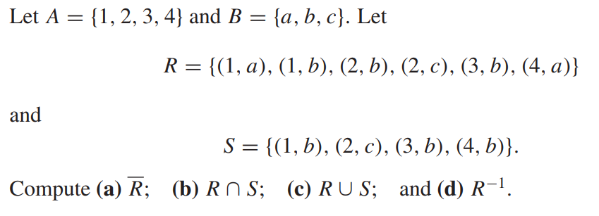
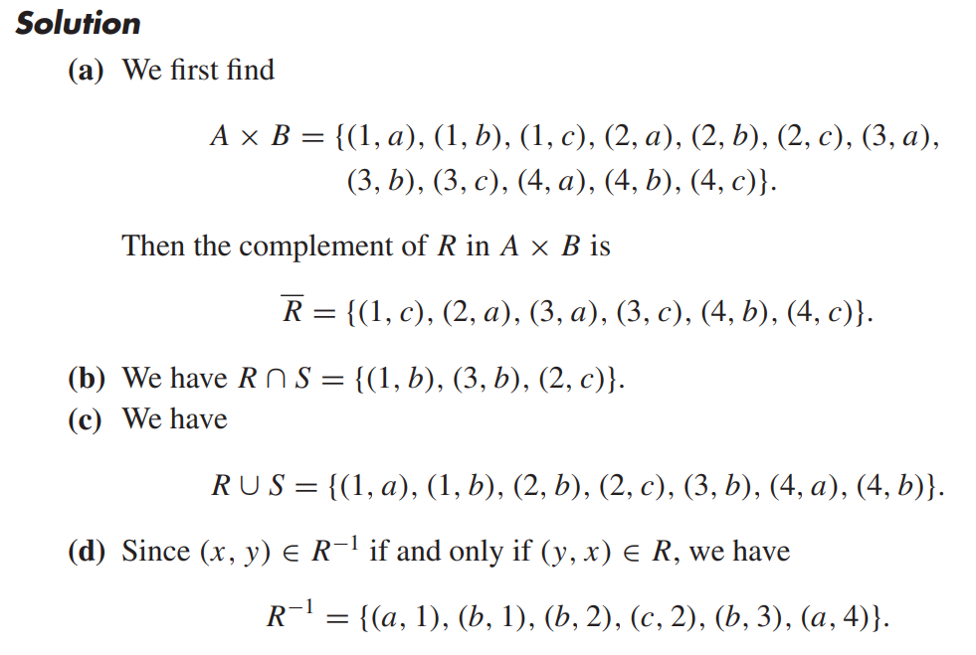
Example1:

Slide 67





Example 2:
Let A = {a, b, c, d, e} and let R and S be two relations on A whose corresponding digraphs are shown in Figure. Find , ,

Slide 68


Example 3:
Let A = {1, 2, 3} and let R and S be relations on A. Suppose that the matrices of R and S are

Slide 69




Recalling the operations on Boolean matrices
if R is a relation on a set A, then
a symmetric relation is a relation R such that

Slide 70



THEOREM 1
THEOREM 2
THEOREM 3

Slide 71


THEOREM 4
THEOREM 5

